Slide 1



HEALTHCARE FACILITY PRESENTATION ON SQL QUERY
Created by: Rakesh Kumar Jha

Slide 2


INTRODUCTION
Sample Database: hospital
With the help of a Hospital Database, this exercises will help you understand simple SQL select queries to advanced multi table JOIN queries.
Sample Database description:
Hospitals are the most important part of our lives, trying to provide the best medical facilities to people suffering from various type of illness, which may be due to change in climate conditions, increased work-load, emotional trauma stress etc. It is very much difficult for the hospital to maintain its day-to-day activities and records manually. That is why a database is required to keep records of all type of activities of a hospital.

Slide 3
List of tables
Physician
Department
Affiliated_with
Procedure
Trained_in
Patient
Nurse
Appointment
Medication
Prescribes
Block
Room
On_call
Stay
Undergoes

Slide 4


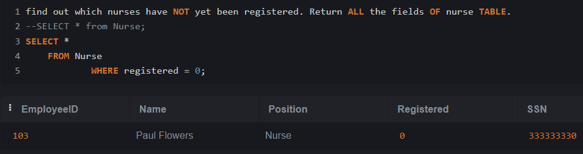

FIND OUT WHICH NURSES HAVE NOT YET BEEN REGISTERED. RETURN ALL THE FIELDS OF NURSE TABLE.

Slide 5

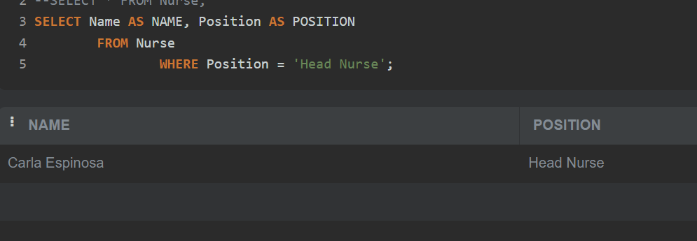
IDENTIFY THE NURSES IN CHARGE OF EACH DEPARTMENT. RETURN NURSENAME AS “NAME”, POSITION AS “POSITION”.

Slide 6

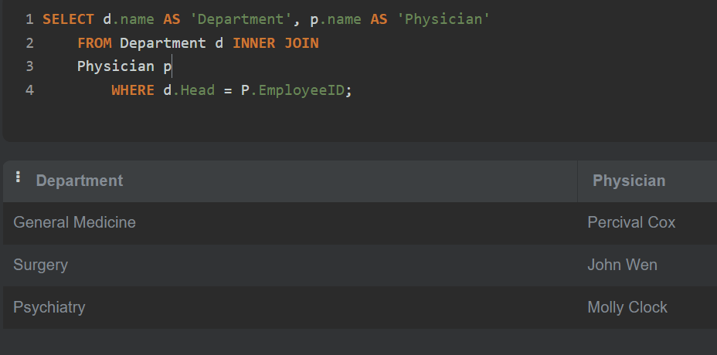

write a SQL query to identify the physicians who are the department heads. Return Department name as “Department” and Physician name as “Physician”.

Slide 7


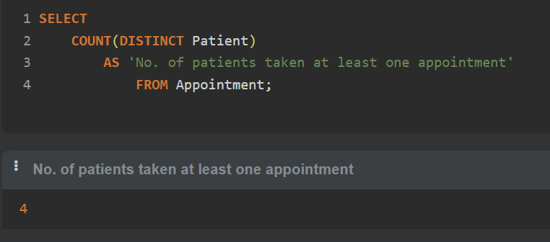
count the number of patients who scheduled an appointment with at least one physician. Return count as "Number of patients taken at least one appointment".

Slide 8
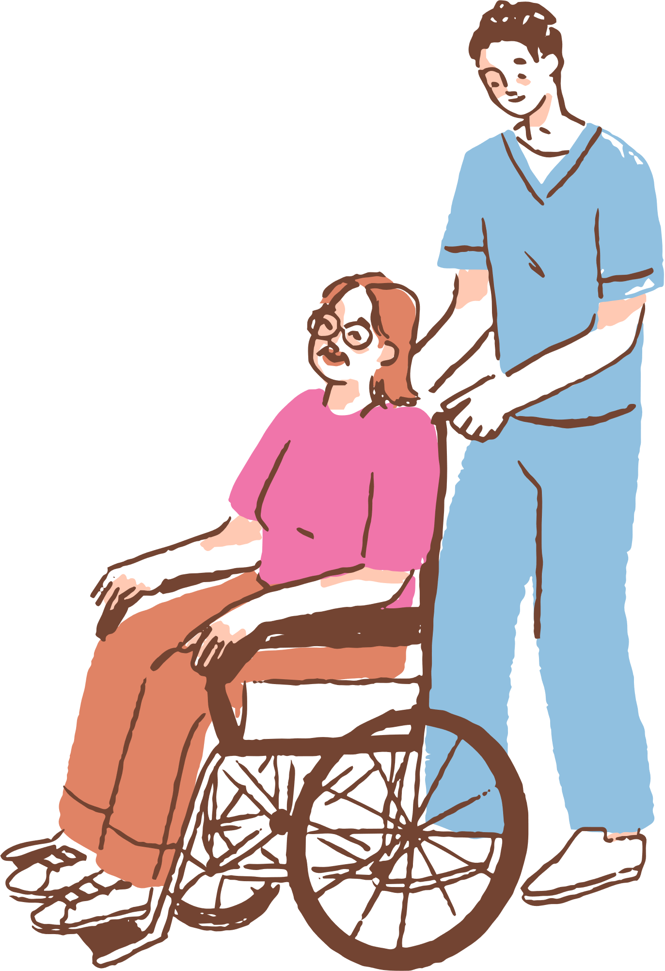
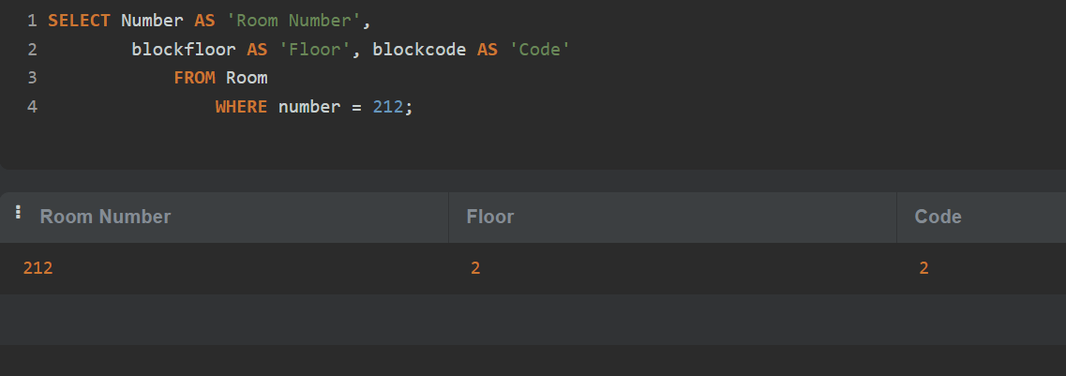
Locate the floor and block where room number 212 is located. Return block floor as "Floor" and block code as "Block".

Slide 9

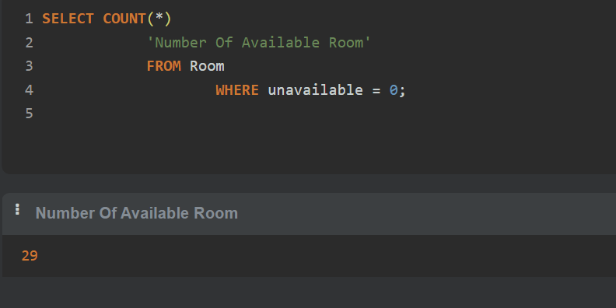

write a SQL query to count the number available rooms. Return count as "Number of available rooms".

Slide 10
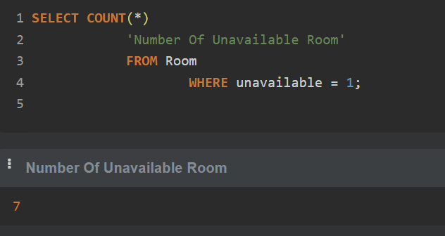

write a SQL query to count the number of unavailable rooms. Return count as "Number of unavailable rooms".

Slide 11

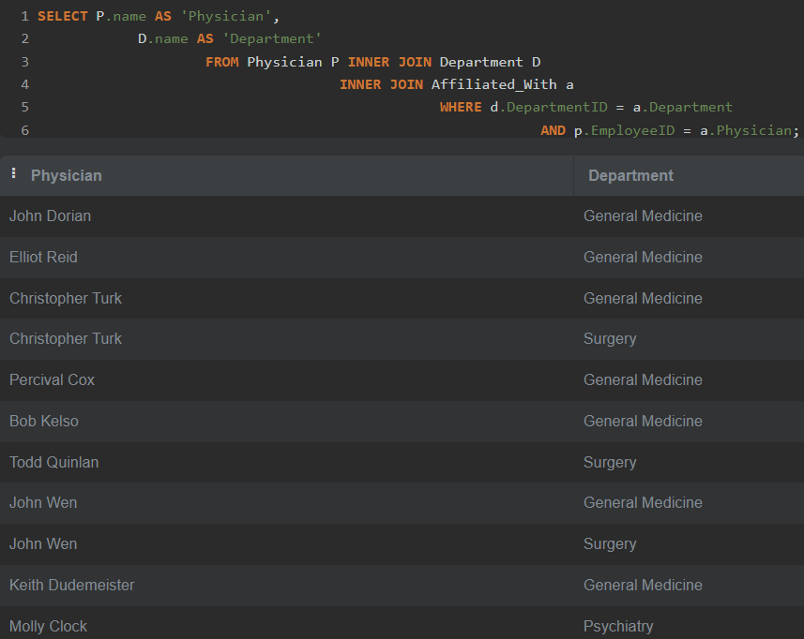

write a SQL query to identify the physician and the department with which he or she is affiliated. Return Physician name as " Physician", and department name as "Department".

Slide 12

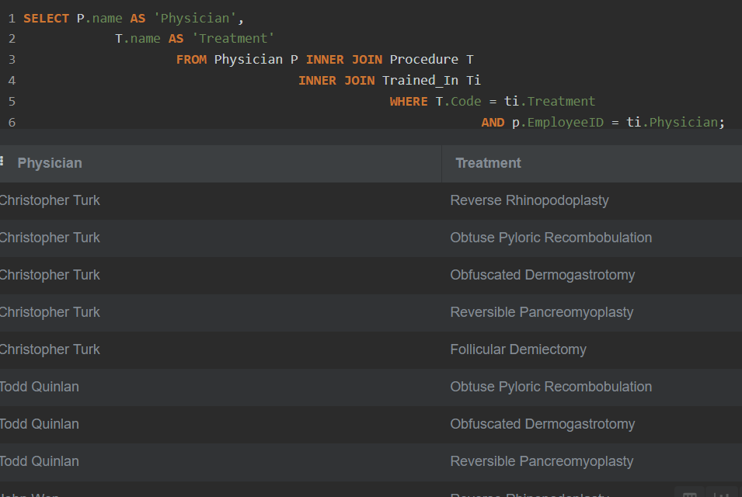
write a SQL query to find those physicians who have received special training. Return Physician name as “Physician”, treatment procedure name as "Treatment".

Slide 13
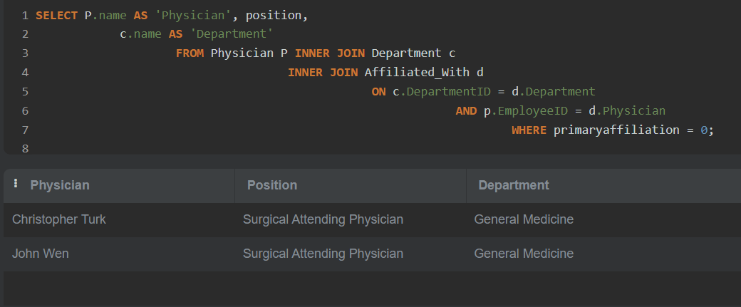
write a SQL query to find those physicians who are yet to be affiliated. Return Physician name as " Physician", Position, and department as "Department".

Slide 14
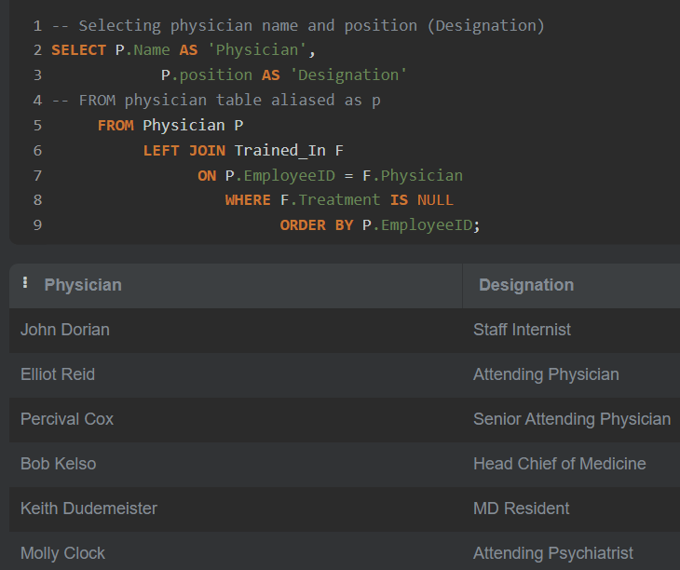
write a SQL query to identify physicians who are not specialists. Return Physician name as " Physician", position as "Designation".

Slide 15
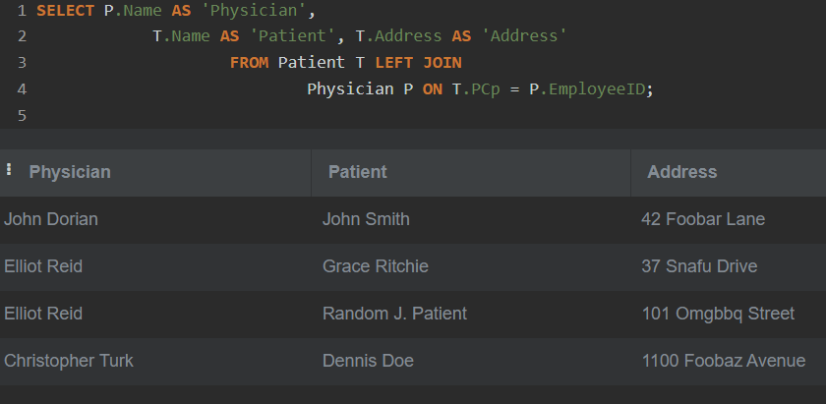
write a SQL query to find the patients with their physicians by whom they received preliminary treatment. Return Patient name as "Patient", address as "Address" and Physician name as " Physician".

Slide 16
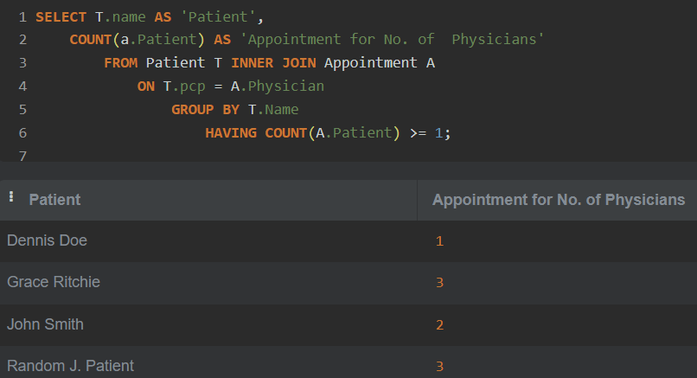
write a SQL query to identify the patients and the number of physicians with whom they have scheduled appointments. Return Patient name as "Patient", number of Physicians as "Appointment for No. of Physicians".

Slide 17
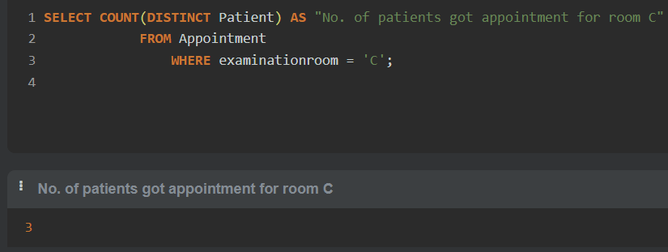
count the number of patients who scheduled an appointment with at least one physician. Return count as "Number of patients taken at least one appointment".

Slide 18
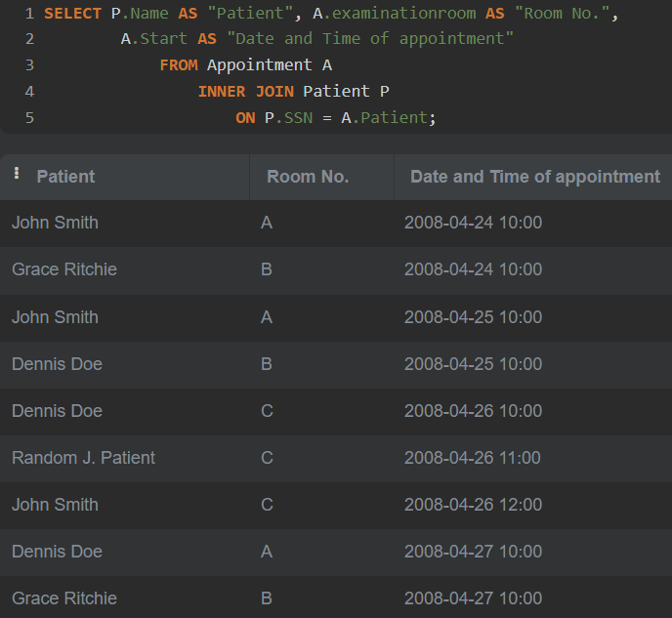
write a SQL query to find the names of the patients and the room number where they need to be treated. Return patient name as "Patient", examination room as "Room No.", and starting date time as Date "Date and Time of appointment".

Slide 19
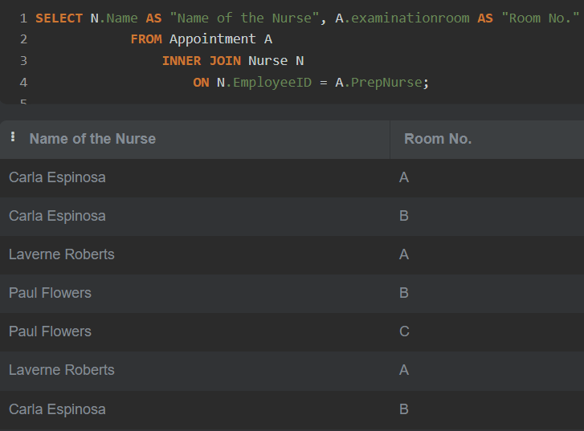
write a SQL query to identify the nurses and the room in which they will assist the physicians. Return Nurse Name as "Name of the Nurse" and examination room as "Room No.".

Slide 20
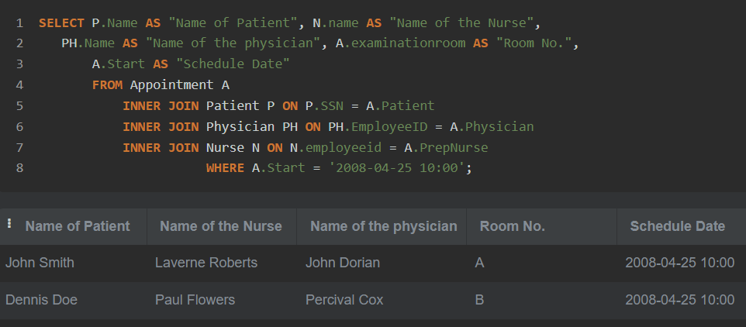
write a SQL query to locate the patients who attended the appointment on the 25th of April at 10 a.m. Return Name of the patient, Name of the Nurse assisting the physician, Physician Name as "Name of the physician", examination room as "Room No.", schedule date and approximate time to meet the physician.

Slide 21
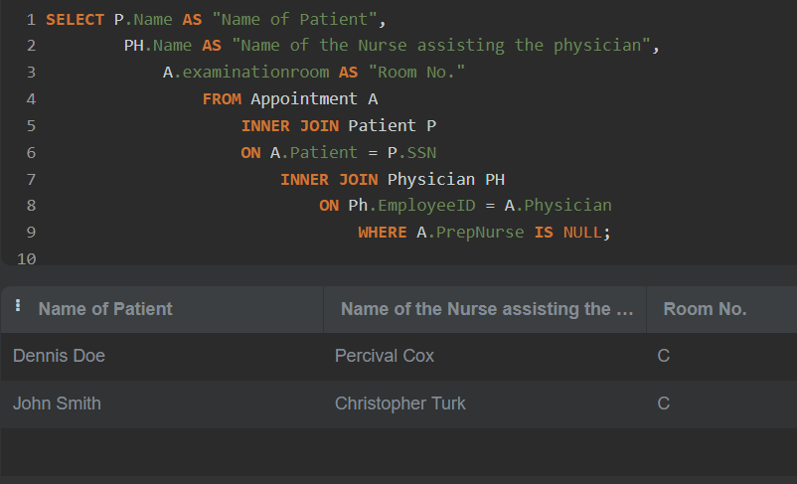
write a SQL query to identify those patients and their physicians who do not require any nursing assistance. Return Name of the patient as "Name of the patient", Name of the Physician as "Name of the physician" and examination room as "Room No."

Slide 22
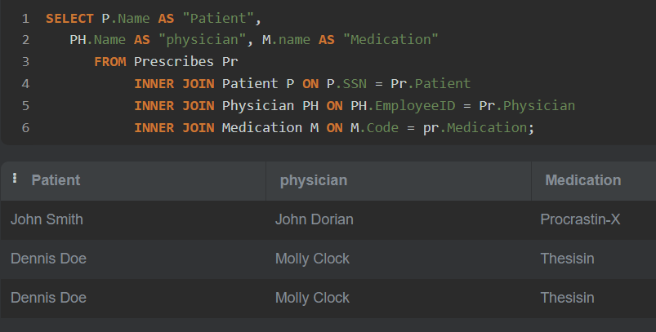
write a SQL query to locate the patients' treating physicians and medications. Return Patient name as "Patient", Physician name as " Physician", Medication name as "Medication".

Slide 23
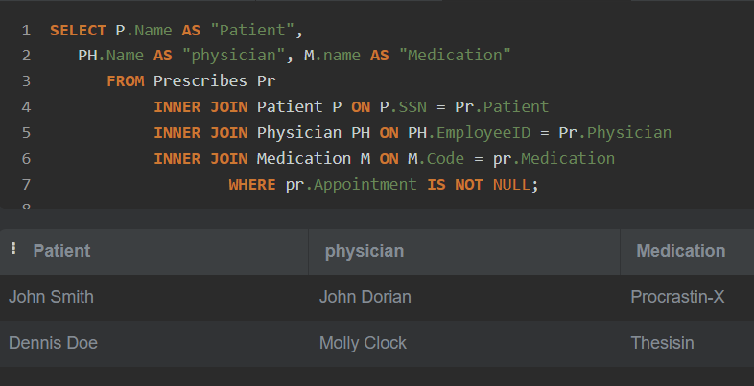
write a SQL query to identify patients who have made an advanced appointment. Return Patient name as "Patient", Physician name as " Physician" and Medication name as "Medication".

Slide 24
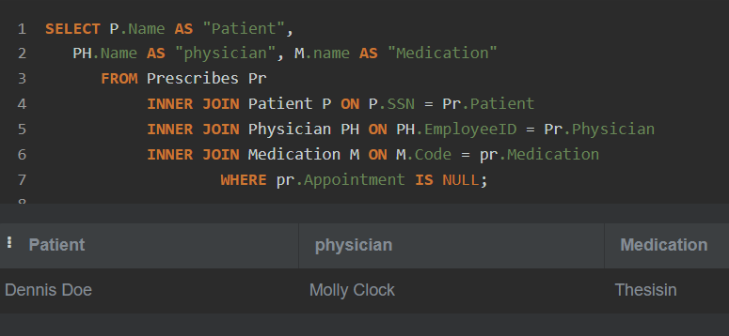
write a SQL query to find those patients who did not schedule an appointment. Return Patient name as "Patient", Physician name as " Physician" and Medication name as "Medication".

Slide 25
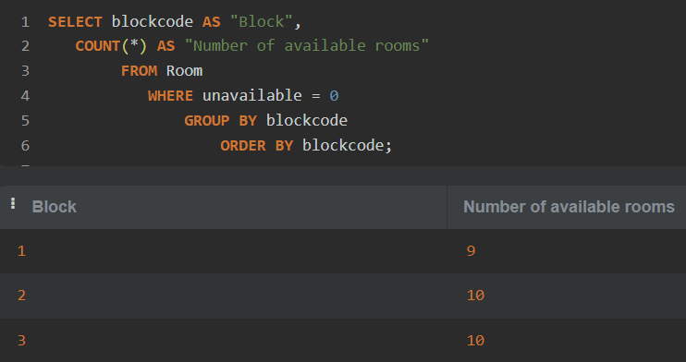
write a SQL query to count the number of available rooms in each block. Sort the result-set on ID of the block. Return ID of the block as "Block", count number of available rooms as "Number of available rooms".

Slide 26
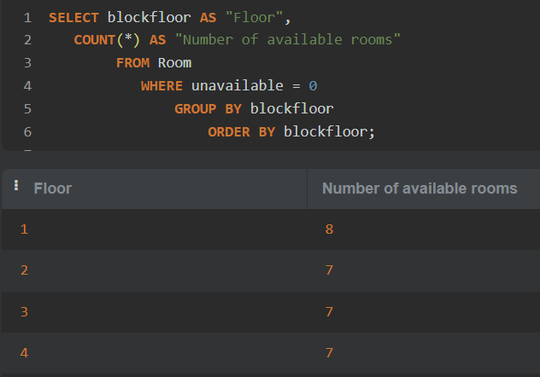
write a SQL query to count the number of available rooms in each floor. Sort the result-set on block floor. Return floor ID as "Floor" and count the number of available rooms as "Number of available rooms".

Slide 27
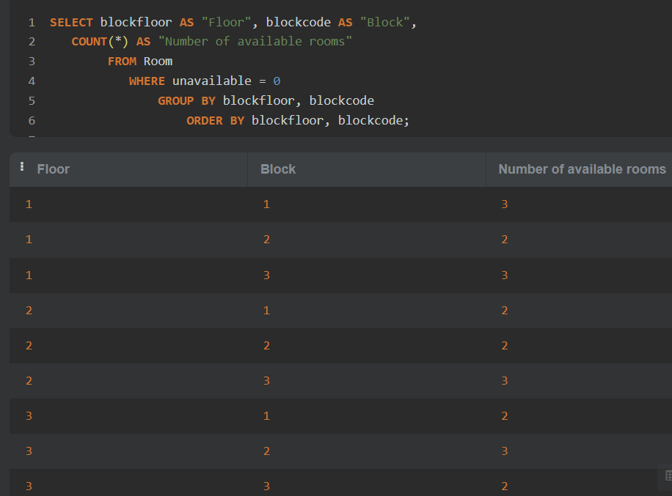
write a SQL query to count the number of available rooms for each floor in each block. Sort the result-set on floor ID, ID of the block. Return the floor ID as "Floor", ID of the block as "Block", and number of available rooms as "Number of available rooms".

Slide 28
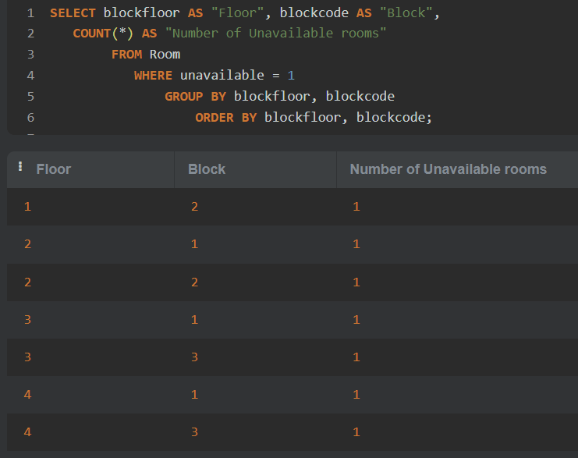
write a SQL query to count the number of rooms that are unavailable in each block and on each floor. Sort the result-set on block floor, block code. Return the floor ID as "Floor", block ID as "Block", and number of unavailable as “Number of unavailable rooms".

Slide 29
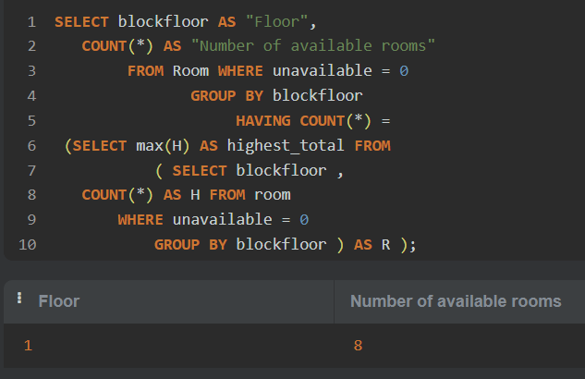
write a SQL query to find the floor where the maximum number of rooms are available. Return floor ID as "Floor", count "Number of available rooms".

Slide 30
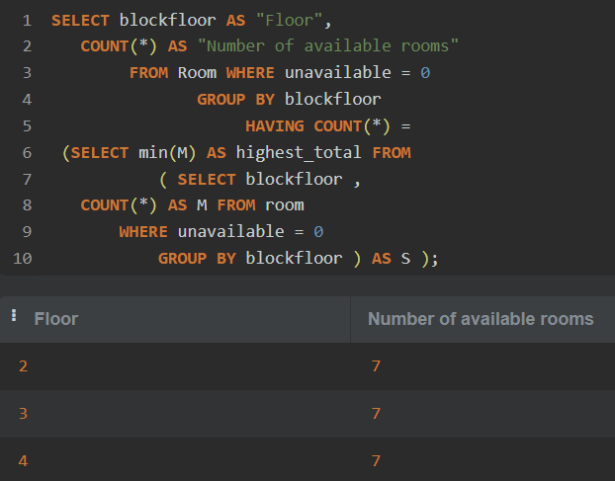
write a SQL query to locate the floor with the minimum number of available rooms. Return floor ID as "Floor", Number of available rooms.

Slide 31
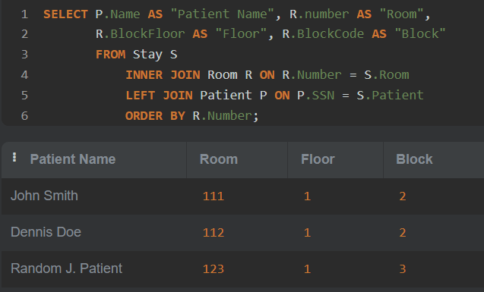
write a SQL query to find the name of the patients, their block, floor, and room number where they admitted.

Slide 32
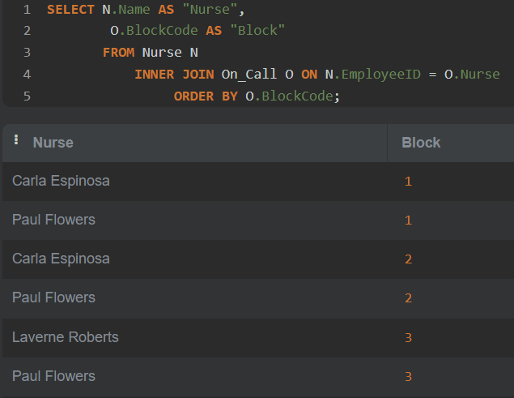
write a SQL query to locate the nurses and the block where they are scheduled to attend the on-call patients. Return Nurse Name as "Nurse", Block code as "Block".

Slide 33
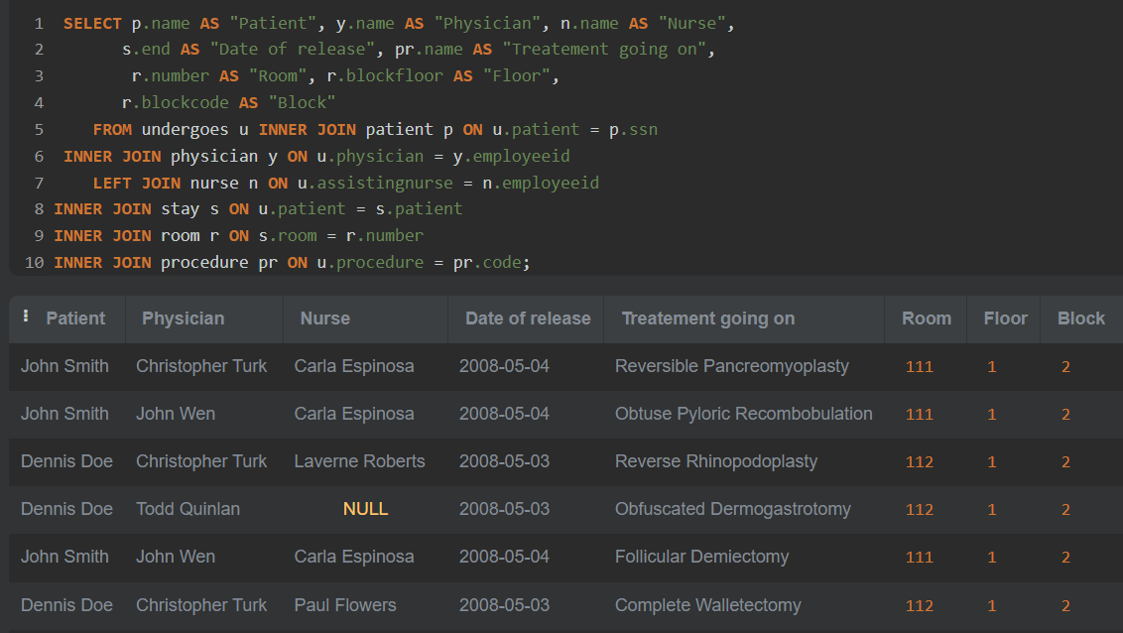
write a SQL query to get name of the patient, name of the physician who is treating him or her, name of the nurse who is attending him or her, which treatment is going on to the patient, the date of release, in which room the patient has admitted and which floor and block the room belongs to respectively.

Slide 34
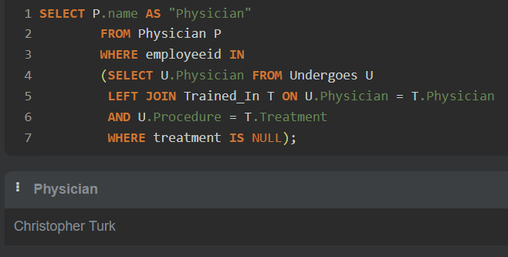
write a SQL query to find all physicians who have performed a medical procedure but are not certified to do so. Return Physician name as " Physician".

Slide 35
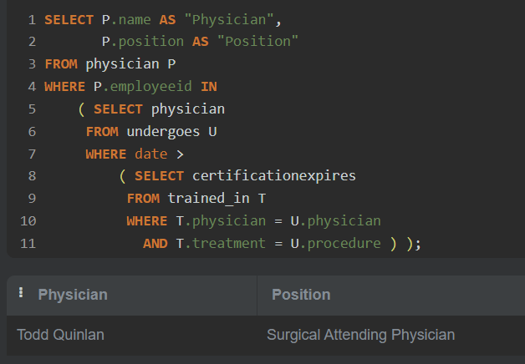
write a SQL query to find all physicians who completed a medical procedure with certification after the expiration date of their license. Return Physician Name as " Physician", Position as "Position".

Slide 36
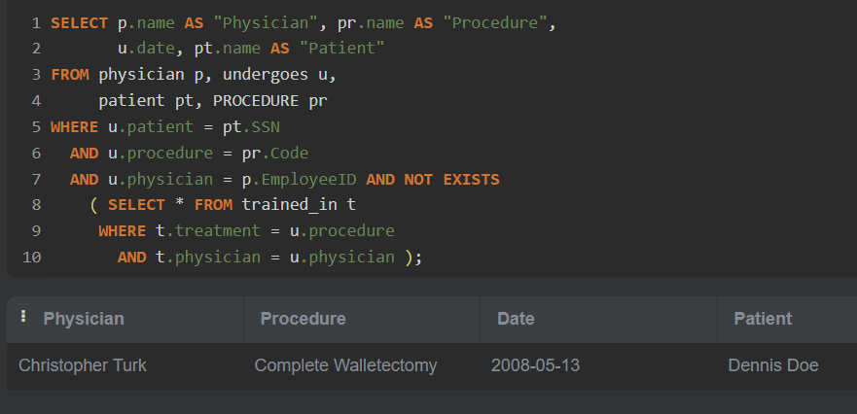
write a SQL query to find all physicians, their procedures, the date when the procedure was performed, and the name of the patient on whom the procedure was performed, but the physicians are not certified to perform that procedure. Return Physician Name as " Physician", Procedure Name as "Procedure", date, and Patient. Name as "Patient".

Slide 37
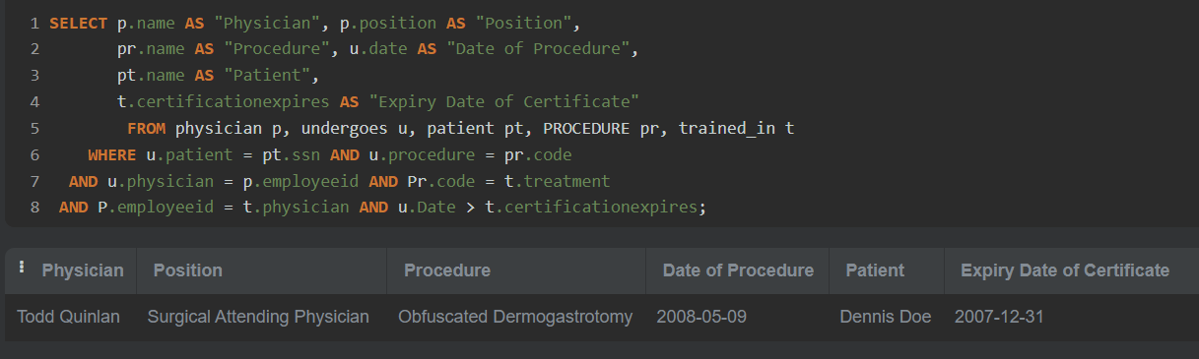
write a SQL query to find all physicians who have completed medical procedures with certification after their certificates expired. Return Physician Name as " Physician", Position as" Position", Procedure Name as "Procedure", Date of Procedure as "Date of Procedure", Patient Name as "Patient", and expiry date of certification as "Expiry Date of Certificate".

Slide 38
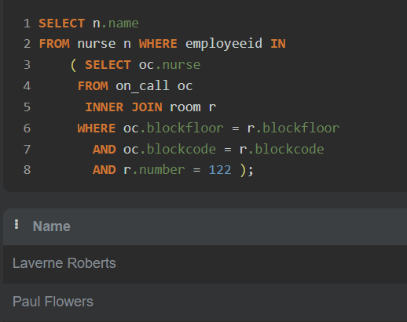
write a SQL query to find out, which nurses have been on call for room 122 in the past. Return name of the nurses.

Slide 39
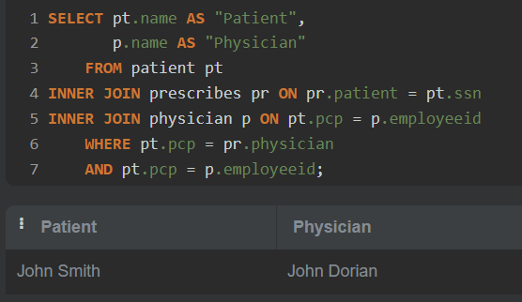
write a SQL query to determine which patients have been prescribed medication by their primary care physician. Return Patient name as "Patient", and Physician Name as " Physician".

Slide 40
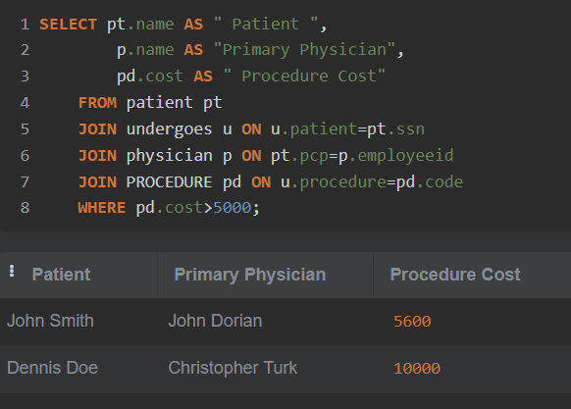
write a SQL query to find those patients who have undergone a procedure costing more than $5,000, as well as the name of the physician who has provided primary care, should be identified. Return name of the patient as "Patient", name of the physician as "Primary Physician", and cost for the procedure as "Procedure Cost".

Slide 41
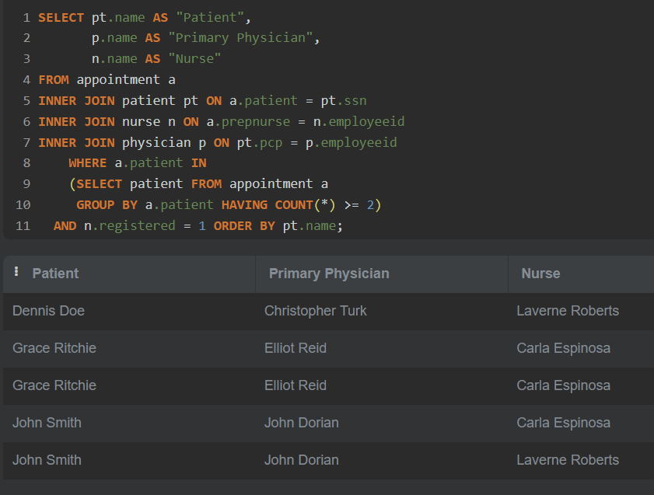
write a SQL query to find those patients with at least two appointments in which the nurse who prepared the appointment was a registered nurse and the physician who provided primary care should be identified. Return Patient name as "Patient", Physician name as "Primary Physician", and Nurse Name as "Nurse".

Slide 42
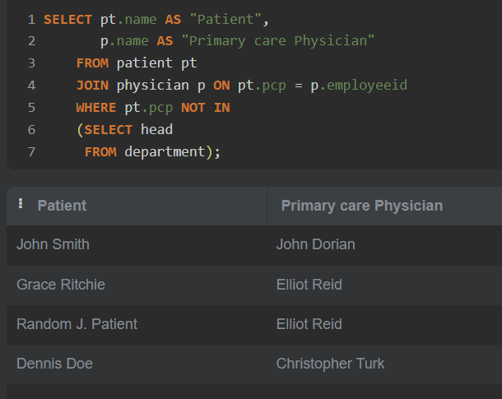
write a SQL query to identify those patients whose primary care is provided by a physician who is not the head of any department. Return Patient name as "Patient", Physician Name as "Primary care Physician".

Slide 43
GET IN TOUCH
ON MY LINKEDIN
https://www.linkedin.com/in/rakesh-kumar-jha-41a84a86/
THANK YOU

